Slide 1

CSE 6363-007: Machine Learning Project - Group 25
Ananthula, Vineeth Kumar (1001953922) Wairagade, Sumedh (1001966019) Vinnakota, Venkatesh (1001876739)
Implementation of Convolutional Neural Networks (CNNs) and Transfer Learning on The CIFAR-10 dataset
This Photo by Unknown author is licensed under CC BY-SA-NC.

Slide 2
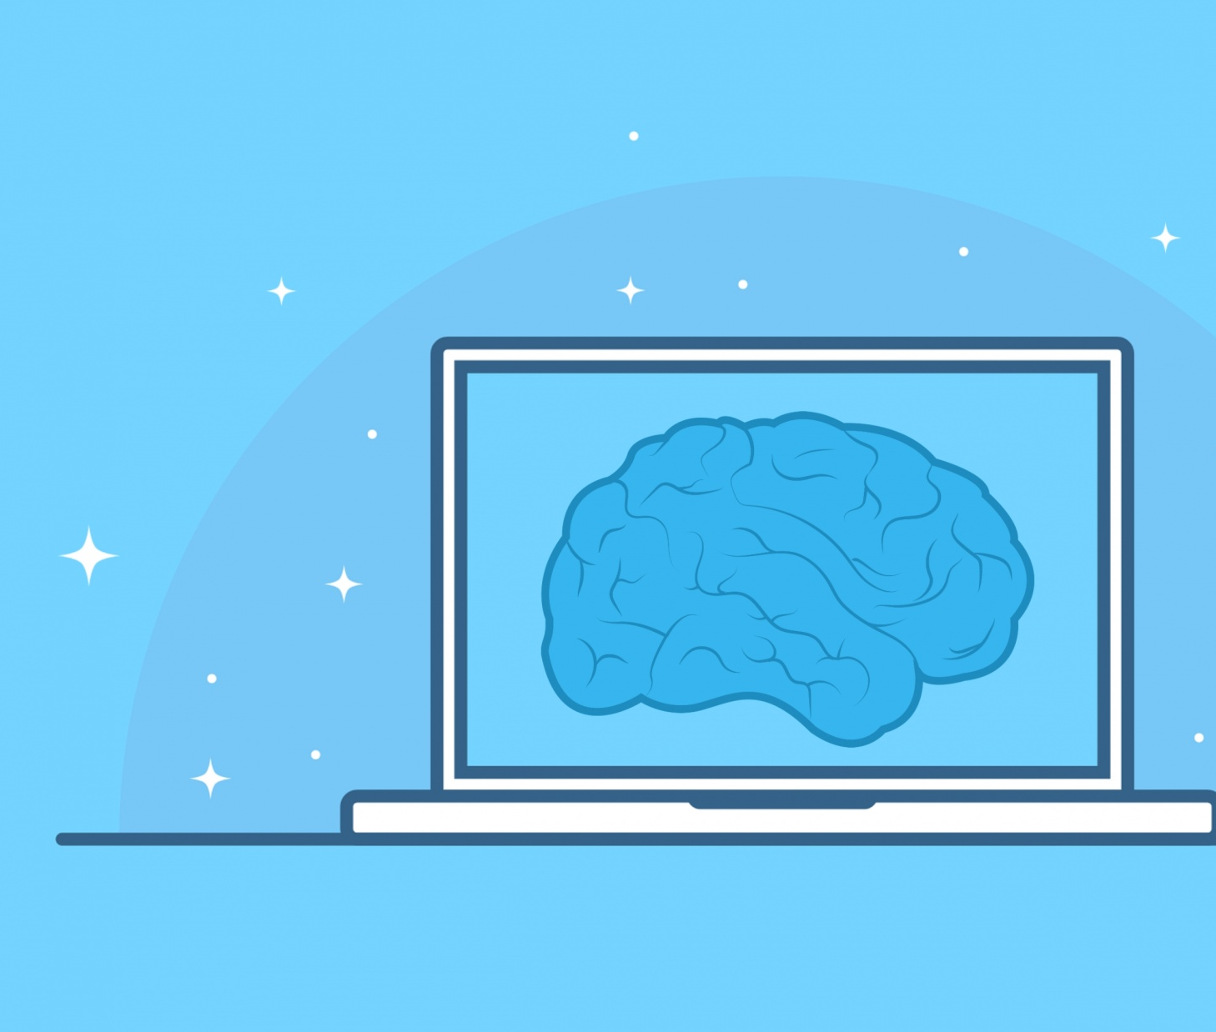
Introduction
Implemented By Mírian Francielle
Use of Convolutional Neural Networks (CNNs) and Transfer Learning on The CIFAR-10 dataset.
In this project we manipulated the data and trained the model to generate an identifier.
We learned the concepts of transfer learning where we use pretrained weights in a different model to perform similar task. This model is based on keras library and CIFAR-10 Dataset.

Slide 3
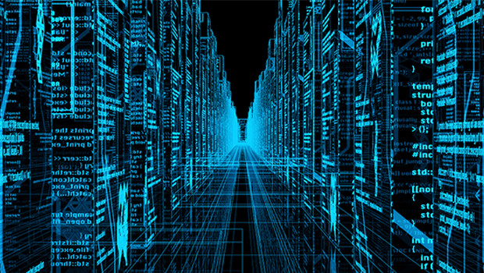
The CIFAR-10 Dataset
The CIFAR-10 dataset contains 60000 pictures of size 32x32x3 divided into 10 classes, each with 6000 images. Split them into 50,000 training and 10,000 test photos.
The dataset is split into five training batches and one test batch, each of which contains ten thousand photos. The test batch comprises exactly 1000 photos from each class, chosen at random. The remaining photos are distributed in random order in the training batches, however certain training batches may contain more images from one class than another. The training batches each include exactly 5000 photos from each class.
This Photo by Unknown author is licensed under CC BY-SA-NC.

Slide 4
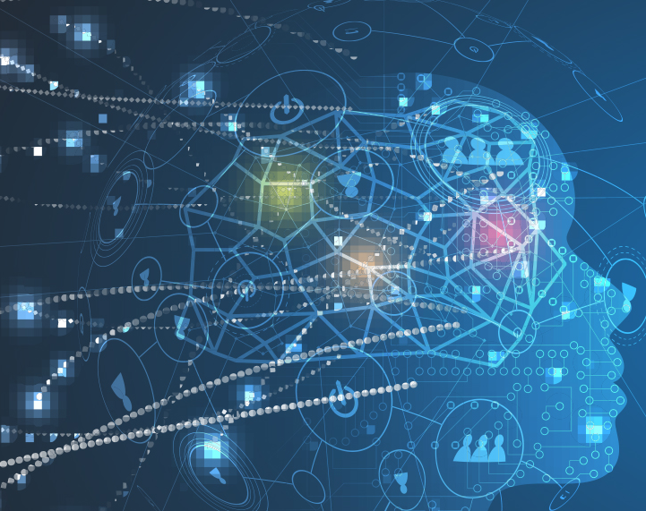
CNN Model
CNN Model is built using Keras VGG19 model.
Where, VGG19 is a 19 layer deep neural networks model, with "ImageNet" weights.
Shape of the Output for one image in this model is (1,1,512).
Activation function used is SoftMax Function to evaluate the result.
This Photo by Unknown author is licensed under CC BY-ND.

Slide 5
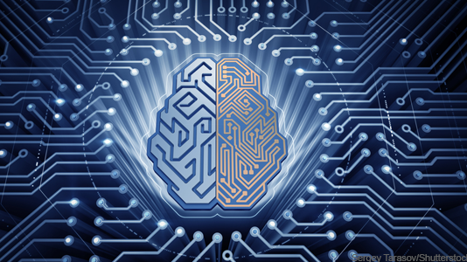
Transfer Learning Model
The core idea behind transfer learning is to take a model that has been trained on a big dataset and apply its knowledge to a smaller dataset.
We freeze the network's early convolutional layers and just train the last few levels that make a prediction.
Convolutional layers extract basic, low-level characteristics that are applicable across pictures, such as edges, patterns, and gradients, whereas subsequent layers detect aspects inside an image, such as eyes or wheels.
This Photo by Unknown author is licensed under CC BY.

Slide 6

Training Model
In VGG19 the model has pretrained weights from the ImageNet challenge in 2014.
Added Flatten layer to get a vector of an output then added dense layers to obtain hot-one's output of 10 nodes for 10 different classes.
Optimizers had learning rate of 0.001 and loss function was 'categorical_crossentropy'.
Trained the model on the 50,000 images with 20 epochs of batch size 128.
Augmented the data by artificially increasing it by applying random transformations.
We obtain loss while training and accuracy in each epoch.
This Photo by Unknown author is licensed under CC BY-NC.

Slide 7

Results
The model sometimes misclassify cats and dogs with each other.
If the number of epochs are increased, then the model starts to overfit the data. So, we had to add a stopping criteria.
For this low resolution maybe, the model does good but can be improved more by optimizing the number of nodes in each layer.
The accuracy of the model is almost stable after a certain number of epochs.

Slide 8
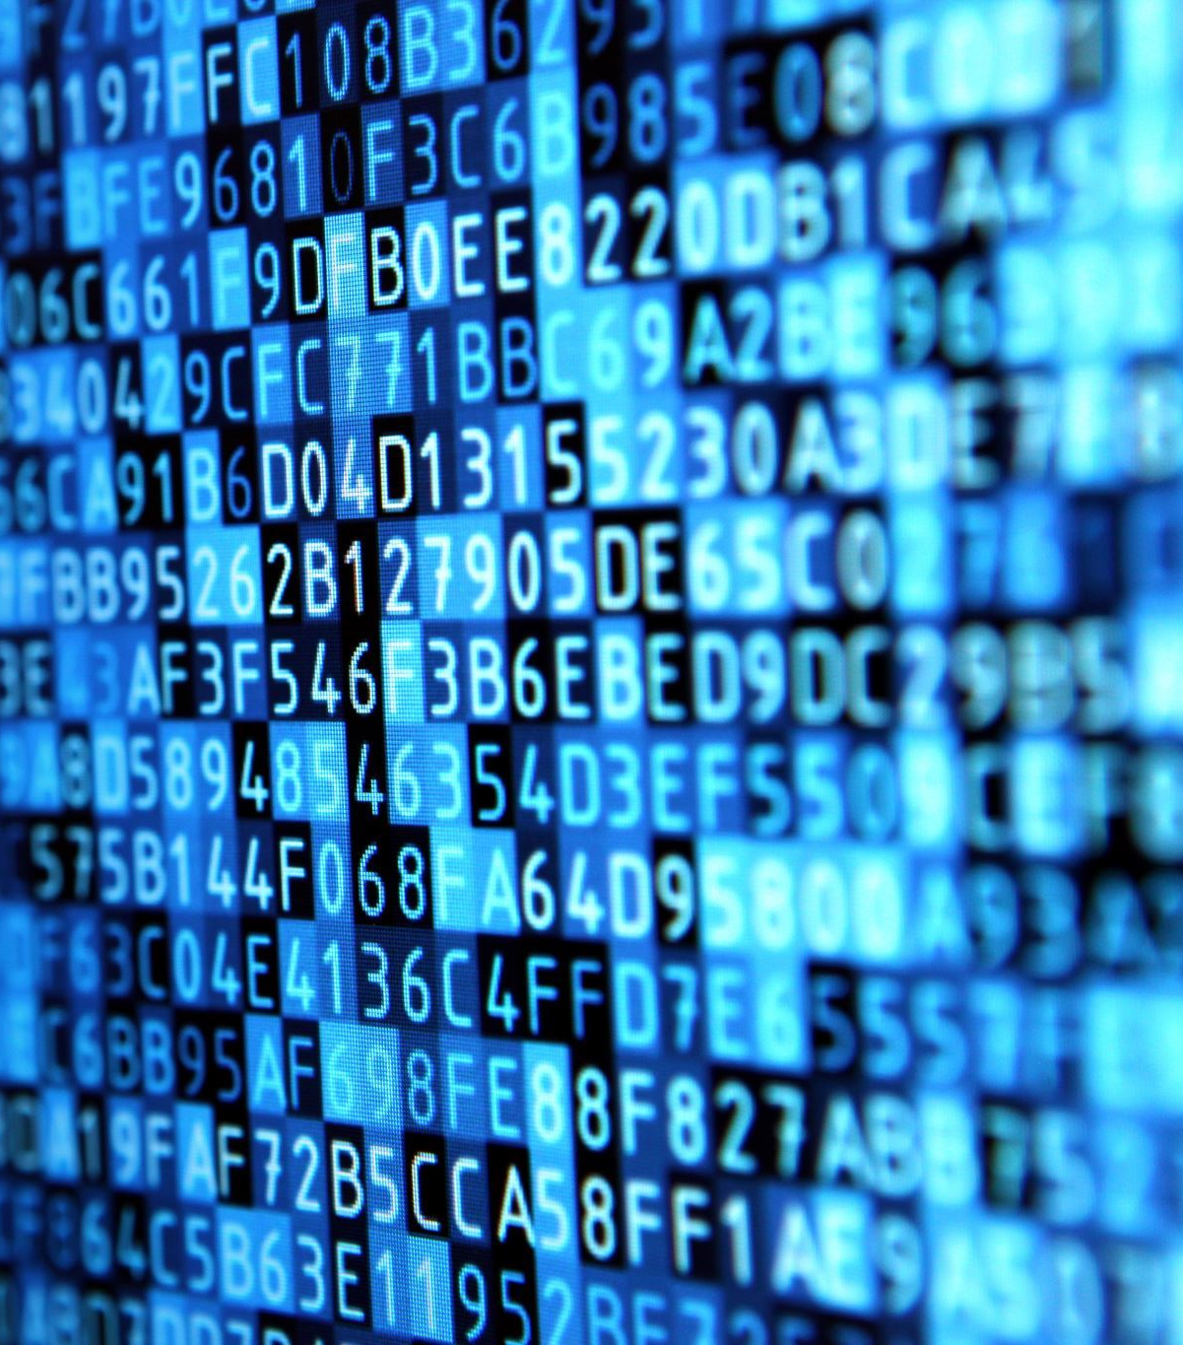
References
Code - https://github.com/mirianfsilva/machine-learning-college-projects/blob/master/deep-learning/transferLearning.ipynb
Dataset - https://www.cs.toronto.edu/~kriz/cifar.html

